Slide 1
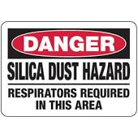
Overview Silica Exposure

Slide 2
Exposure and Health Risks
Exposure to respirable crystalline silica has been linked to:
Chronic Silicosis -10 years of exposure,
Accelerated Silicosis - less than 5 years of exposure or
Acute Silicosis - less than 2 years, can be several months.
Increased levels of lung cancer
Chronic Obstructive Pulmonary Disease (COPD) and
Renal, kidney and immune system disease’s.
Notes:
Quartz, cristobalite, tridymite from chipping, cutting, sawing, drilling, grinding, sanding, and crushing of concrete, brick, block, rock, and stone products

Slide 3
How is OSHA addressing exposure to crystalline silica?
OSHA has a National Emphasis Program (NEP) for Crystalline Silica exposure to identify, reduce, and eliminate health hazards associated with occupational exposures.
OSHA has an established Permissible Exposure Limit, the maximum amount of crystalline silica to which workers may be exposed to during an 8-hour work shift.
OSHA requires haz-com training for workers exposed to crystalline silica, and requires a respiratory protection program until engineered controls are implemented.

Slide 4
Construction- Scope
All occupational exposures to respirable crystalline silica are covered, unless employee exposure will remain below 25 μg/m³ as an 8-hr TWA under any foreseeable conditions.
– Respiratory protection;
– Housekeeping;
– Written exposure assessment;
– Medical surveillance;
– Hazard communication; and
– Recordkeeping.

Slide 5
Engineering and Work Practice Controls
Table 1 in the construction standard matches 18 tasks with effective dust control methods and, in some cases, respirator requirements.
Employers that fully and properly implement the engineered controls in Table 1 do not have to:
Comply with the PEL of Silica in excess of 50ug/m3 over an 8 hour time frame. 1926.1153(d)(1)
Conduct exposure assessments for employees engaged in those tasks. 1926.1153(d)(2)(iii)(3)

Slide 6
Assigned Protection Factor (APF)
Assigned Protection Factor (APF) is the workplace level of respiratory protection that a respirator or class of respirators is expected to provide to employees when the employer implements a continuing, effective respiratory protection program as specified by this section.

Slide 7
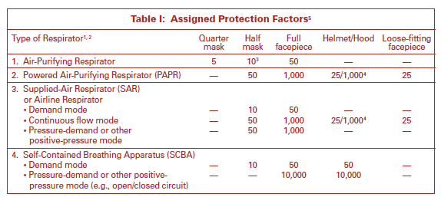
Example of APF

Slide 8
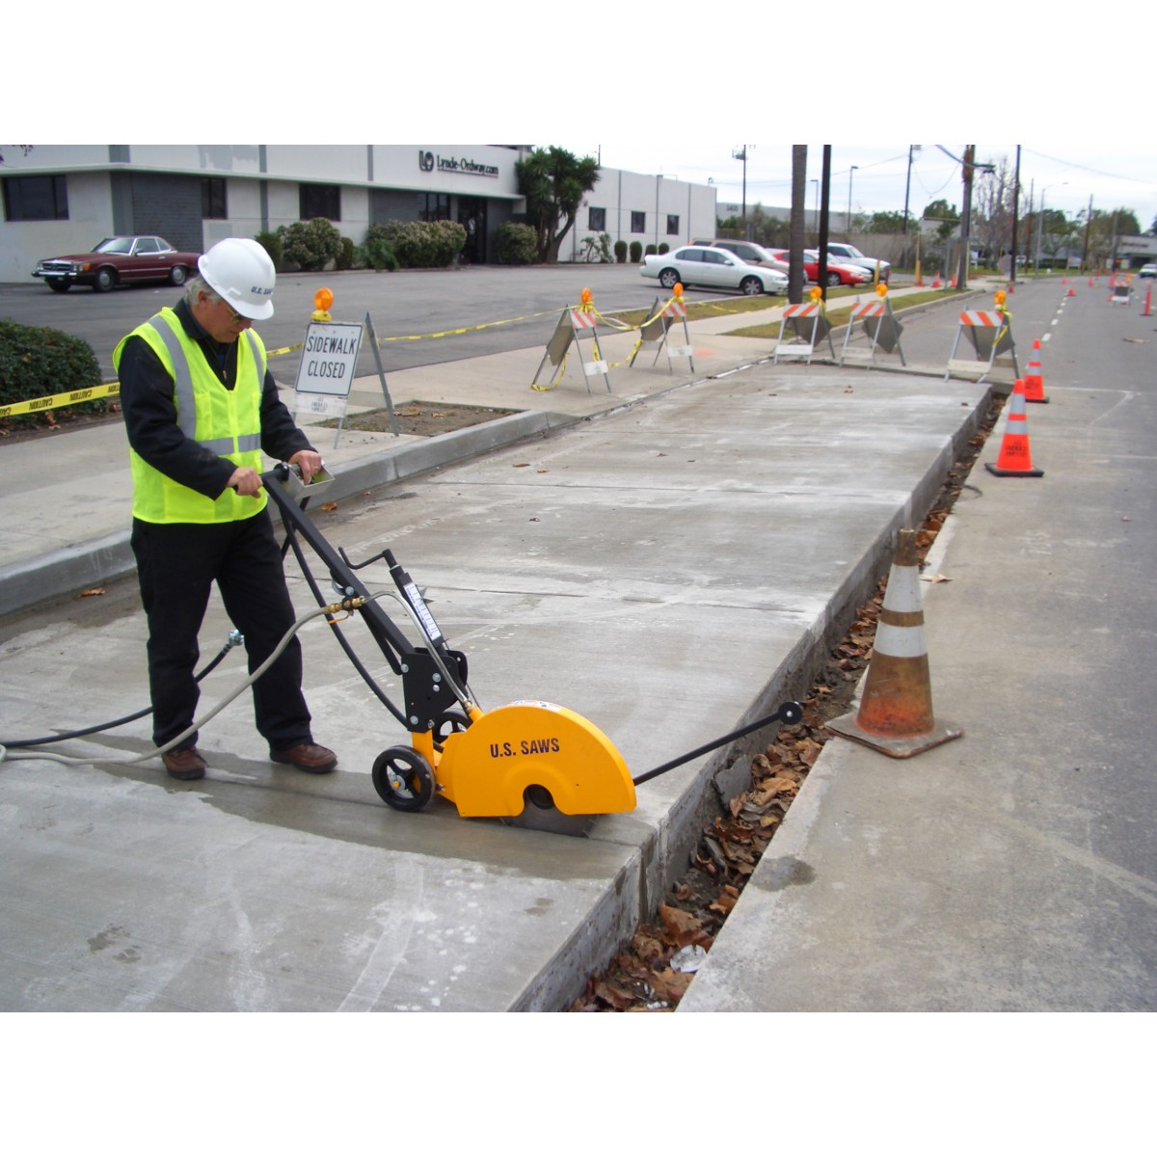
18 Operations under Table 1
Use of walk-behind saw
Notes:
Use an Integrated water delivery system that continuously feeds water past the blade.
Operate and maintain the tool in accordance with the manufacturers instructions to minimize dust emissions.
When the saw is used outdoors there is no assigned protection factor.
When the saw is used in an enclosed area or indoors, the assigned protection factor is 10.

Slide 9
18 Operations under Table 1
Jackhammers and handheld powered chipping tools
Notes:
Use of a tool with water delivery system that supplies a continuous stream or spray of water at the point of impact:
When used outdoors for less than 4 hours- No APF
When used outdoors for more than 4 hours-APF 10
When used indoors or in an enclosed area APF 10 OR,
Use tool equipped with commercially available shroud and dust collection system
Operate and maintain tool in accordance with manufacturer's instructions to minimize dust emissions
Note: Dust collector must provide the air flow recommended by the tool manufacturer, or greater, and have a filter with 99% or greater efficiency and a filter-cleaning mechanism:-

Slide 10
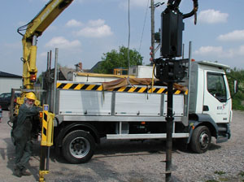
18 Operations under Table 1
Use of rig-mounted earth-drilling rigs for rock and concrete
Notes:
Use a dust collection system with a close capture hood or shroud around the drill bit with a low flow water spray to wet the dust at the discharge point from the collector or
Operate from an enclosed cab and use water for dust suppression on the drill bit.
No Assigned Protection Factor for this operation.

Slide 11
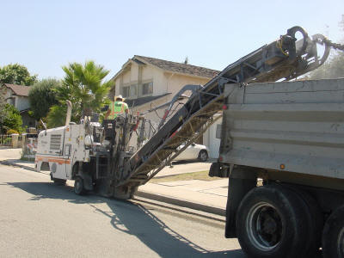
18 Operations under Table 1
Use of drivable milling machines
Notes:
Small drivable milling machines (less than half-lane)- No APF if
Use a machine equipped with supplemental water sprays designed to suppress dust.
Water must be combined with a surfactant.
Large drivable milling machines (half-lane and larger)- No APF if
For cuts of any depth on asphalt only: Use machine equipped with exhaust ventilation on drum enclosure and supplemental water sprays designed to suppress dust.
Operate and maintain machine to minimize dust emissions.
For cuts of four inches in depth or less on any substrate:
Use machine equipped with exhaust ventilation on drum enclosure and supplemental water sprays designed to suppress dust.
Operate and maintain machine to minimize dust emissions OR,
Use a machine equipped with supplemental water spray designed to suppress dust. Water must be combined with a surfactant.
Operate and maintain machine to minimize dust emissions

Slide 12
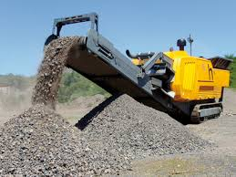
18 Operations under Table 1
Rock Crushing
Notes:
No APF’s if:
Use equipment designed to deliver water spray or mist for dust suppression at crusher and other points where dust is generated (e.g., hoppers, conveyers, sieves/sizing or vibrating components, and discharge points)
Operate and maintain machine in accordance with manufacturer's instructions to minimize dust emissions
Use a ventilated booth that provides fresh, climate-controlled air to the operator, or a remote control station

Slide 13
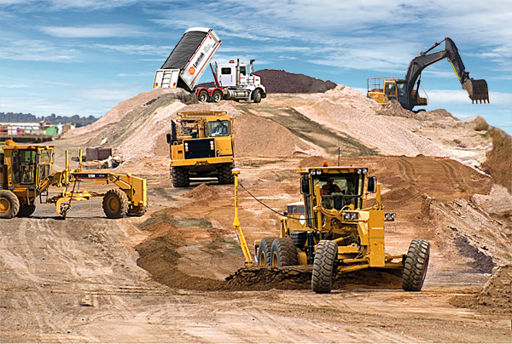
18 Operations under Table 1
Use of heavy equipment during earthmoving
Notes:
Heavy equipment and utility vehicles used to abrade or fracture silica-containing materials (e.g., hoe-ramming, rock ripping) or used during demolition activities involving silica-containing materials. There are no APF’s if:
Operate equipment from within an enclosed cab.
When employees outside of the cab are engaged in the task, apply water and/or dust suppressants as necessary to minimize dust emissions.
(xviii) Heavy equipment and utility vehicles for tasks such as grading and excavating but not including: Demolishing, abrading, or fracturing silica-containing materials.
Apply water and/or dust suppressants as necessary to minimize dust emissions. OR,
When the equipment operator is the only employee engaged in the task, operate equipment from within an enclosed cab.

Slide 14
Table 1 Tasks
Stationary masonry saws
Handheld power saws
Handheld power saws for fiber cement board
Walk-behind saws
Drivable saws
Rig-mounted core saws or drills
Handheld and stand-mounted drills
Dowel drilling rigs for concrete
Vehicle-mounted drilling rigs for rock and concrete
Jackhammers and handheld powered chipping tools
Handheld grinders for mortar removal (tuckpointing)
Handheld grinders for other than mortar removal
Walk-behind milling machines and floor grinders
(2) Small/Large drivable milling machines
Crushing machines
Heavy equipment and utility vehicles to abrade or fracture silica materials
Heavy equipment and utility vehicles for grading and excavating

Slide 15
Who is Engaged with Table 1?
Employees are “engaged in the task” when operating the listed equipment, assisting with the task, or have some responsibility for the completion of the task
Employees are not “engaged in the task” if they are only in the vicinity of a task

Slide 16
Respiratory Protection Requirements on Table 1
Respirators required where exposures above the PEL are likely to persist despite full and proper implementation of the specified engineering and work practice controls
Where respirators required, must be used by all employees engaged in the task for entire duration of the task
Provisions specify how to determine when respirators are required for an employee engaged in more than one task

Slide 17
Control Method 2 Exposure Assessment
1926.1153(d)(2)(i) General. The employer shall assess the exposure of each employee who is or may reasonably be expected to be exposed to respirable crystalline silica at or above the action level in accordance with either the performance option in paragraph (d)(2)(ii) or the scheduled monitoring option in paragraph (d)(2)(iii) of this section.
1926.1153(d)(2)(ii)
Performance option. The employer shall assess the 8-hour TWA exposure foreach employee on the basis of any combination of air monitoring data or objective data sufficient to accurately characterize employee exposures to respirable crystalline silica.

Slide 18
Construction – Written Exposure Control Plan
The plan must describe:
Tasks involving exposure to respirable crystalline silica
Engineering controls, work practices, and respiratory protection for each task
Housekeeping measures used to limit exposure
Procedures used to restrict access, when necessary to limit exposures

Slide 19
Construction – Competent Person
Construction employers must designate a competent person to implement the written exposure control plan
Competent person is an individual capable of identifying existing and foreseeable respirable crystalline silica hazards, who has authorization to take prompt corrective measures
Makes frequent and regular inspection of job sites, materials, and equipment

Slide 20
Construction – Medical Surveillance
Employers must offer medical examinations to workers:
Who will be required to wear a respirator under the standard for 30 or more days a year.
Employers must offer examinations every three years to workers who continue to be exposed above the trigger
Exam includes medical and work history, physical exam, chest X-ray, and pulmonary function test (TB test on initial exam only)

Slide 21
Construction – Compliance Dates
Employers must comply with all requirements (except methods of sample analysis) by June 23, 2017
Compliance with methods of sample analysis required by June 23, 2018

Slide 22
Contact Information for On-Site Training
Chris Hayes, CIH
Kentucky Labor Cabinet
Office of Workplace Standards
Div. of Education and Training, Health Branch
1047-US HWY 127-S Ste.#4
Frankfort, KY 40601 (502) 229-9884
chris.hayes@ky.gov

Slide 23
For consultative services and publications contact:
Kimberlee Perry, Assistant Director
Department of Workplace Standards Office of Occupational Safety and Health Division of Education and Training
1047 US Highway 127 S, Suite 4 Frankfort, KY 40601 (502) 564-3070
Kentucky Labor Cabinet Home Page: www.labor.ky.gov

